Slide 1
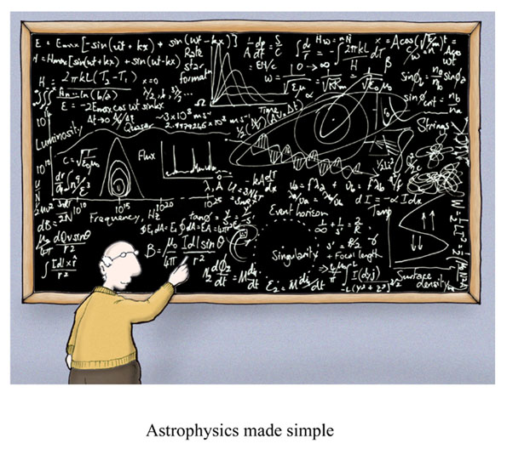
Uncertainty and Significant Figures
Cartoon courtesy of Lab-initio.com

Slide 2
Uncertainty in Measurement
A digit that must be estimated is called uncertain. A measurement always has some degree of uncertainty.

Slide 3
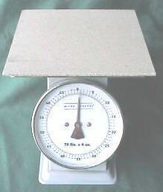
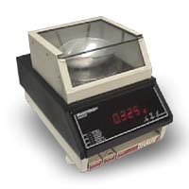
Why Is there Uncertainty?
Measurements are performed with instruments
No instrument can read to an infinite number of decimal places
Which of these balances has the greatest uncertainty in measurement?

Slide 4
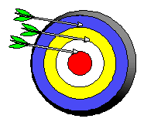
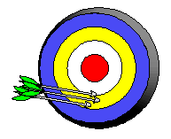
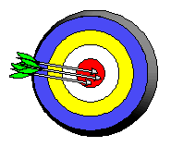
Precision and Accuracy
Accuracy refers to the agreement of a particular value with the true value.
Precision refers to the degree of agreement among several measurements made in the same manner.
Neither accurate nor precise
Precise but not accurate
Precise AND accurate

Slide 5
Types of Error
Random Error (Indeterminate Error) - measurement has an equal probability of being high or low.
Systematic Error (Determinate Error) - Occurs in the same direction each time (high or low), often resulting from poor technique or incorrect calibration.

Slide 6
Rules for Counting Significant Figures - Details
Nonzero integers always count as significant figures.
3456 has
4 significant figures

Slide 7
Rules for Counting Significant Figures - Details
Zeros
- Leading zeros do not count as
significant figures.
0.0486 has
3 significant figures

Slide 8
Rules for Counting Significant Figures - Details
Zeros
- Captive zeros always count as
significant figures.
16.07 has
4 significant figures

Slide 9
Rules for Counting Significant Figures - Details
Zeros
Trailing zeros are significant only if the number contains a decimal point.
9.300 has
4 significant figures

Slide 10
Rules for Counting Significant Figures - Details
Exact numbers have an infinite number of significant figures.
1 inch = 2.54 cm, exactly

Slide 11
Sig Fig Practice #1
How many significant figures in each of the following?
1.0070 m →
5 sig figs
17.10 kg →
4 sig figs
100,890 L →
5 sig figs
3.29 x 10³ s →
3 sig figs
0.0054 cm →
2 sig figs
3,200,000 →
2 sig figs

Slide 12
Rules for Significant Figures in Mathematical Operations
Multiplication and Division: # sig figs in the result equals the number in the least precise measurement used in the calculation.
6.38 x 2.0 =
12.76 → 13 (2 sig figs)

Slide 13
Sig Fig Practice #2
Calculation
Calculator says:
Answer
3.24 m x 7.0 m
22.68 m²
23 m²
100.0 g ÷ 23.7 cm³
4.219409283 g/cm³
4.22 g/cm³
0.02 cm x 2.371 cm
0.04742 cm²
0.05 cm²
710 m ÷ 3.0 s
236.6666667 m/s
240 m/s
1818.2 lb x 3.23 ft
5872.786 lb·ft
5870 lb·ft
1.030 g ÷ 2.87 mL
2.9561 g/mL
2.96 g/mL

Slide 14
Rules for Significant Figures in Mathematical Operations
Addition and Subtraction: The number of decimal places in the result equals the number of decimal places in the least precise measurement.
6.8 + 11.934 =
18.734 → 18.7 (3 sig figs)

Slide 15
Sig Fig Practice #3
Calculation
Calculator says:
Answer
3.24 m + 7.0 m
10.24 m
10.2 m
100.0 g - 23.73 g
76.27 g
76.3 g
0.02 cm + 2.371 cm
2.391 cm
2.39 cm
713.1 L - 3.872 L
709.228 L
709.2 L
1818.2 lb + 3.37 lb
1821.57 lb
1821.6 lb
2.030 mL - 1.870 mL
0.16 mL
0.160 mL

